Slide 1

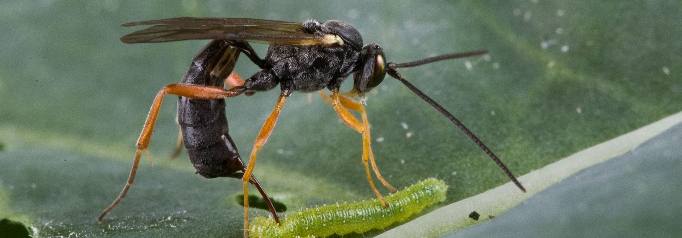
Comparative ecology of sexual and asexual parasitoid wasps
Cyril Matthey-Doret
Supervised by Casper Van Der Kooi
Directed by Tanja Schwander

Slide 2
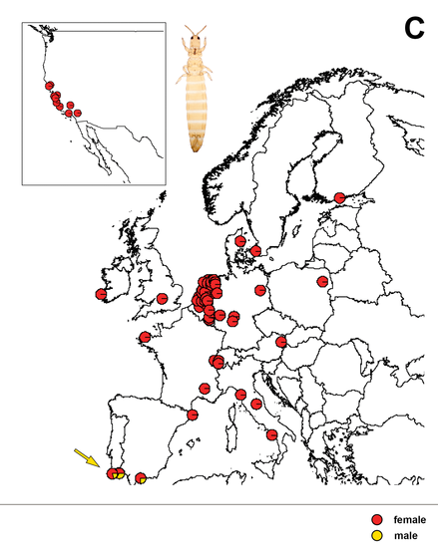
Background
Asexual and sexual species were often found to differ in host range and geographical distribution.
Never tested on a large scale analysis
Aptinothrips rufus
van der Kooi, C. J. and Schwander, T. (2014). Evolution

Slide 3
The study
Do asexuals and sexuals have different ecologies and distributions ?
Do asexuals have more host species ?
Do asexuals occupy larger regions than sexuals ?
Focusing on the Chalcidoidea superfamily

Slide 4
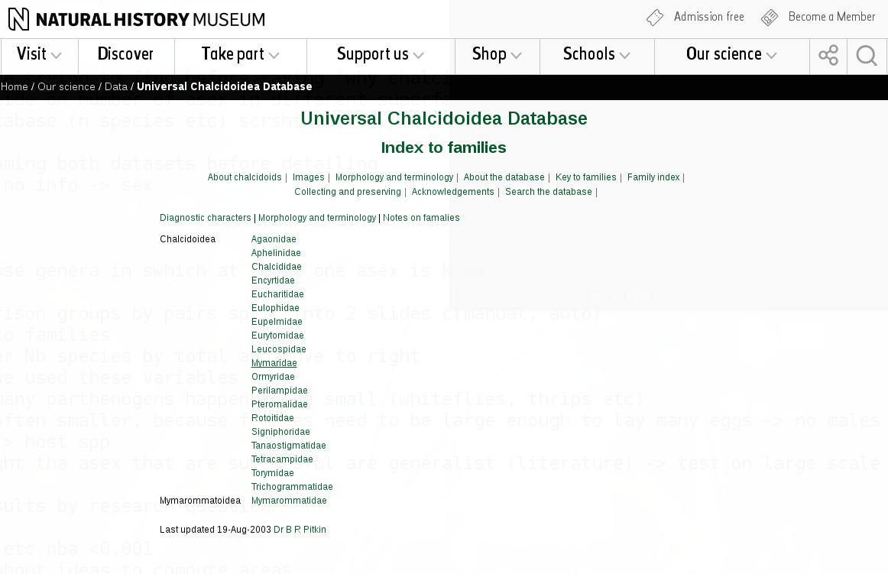
Why Chalcidoidea ?
Many parthenogenetic species
Well studied, many species relevant for biocontrol.
Great database available!
Records for ~31'000 species of Chalcidoidea
host species and distribution

Slide 5


Manual dataset
Gathered by hand in literature
Comparison sex vs asex between the most closely related species
Automated dataset
All data from the same database
Comparing asex vs sex in each genera
Genus
Family
Pair 1
Pair 2
133 species across 32 pairs
50 asexuals, 83 sexuals
8357 species across 66 genera
136 asexuals, 8221 sexuals
asex
sex

Slide 6
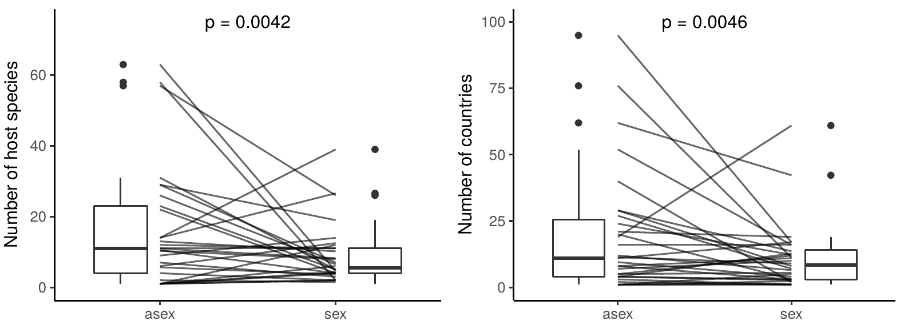
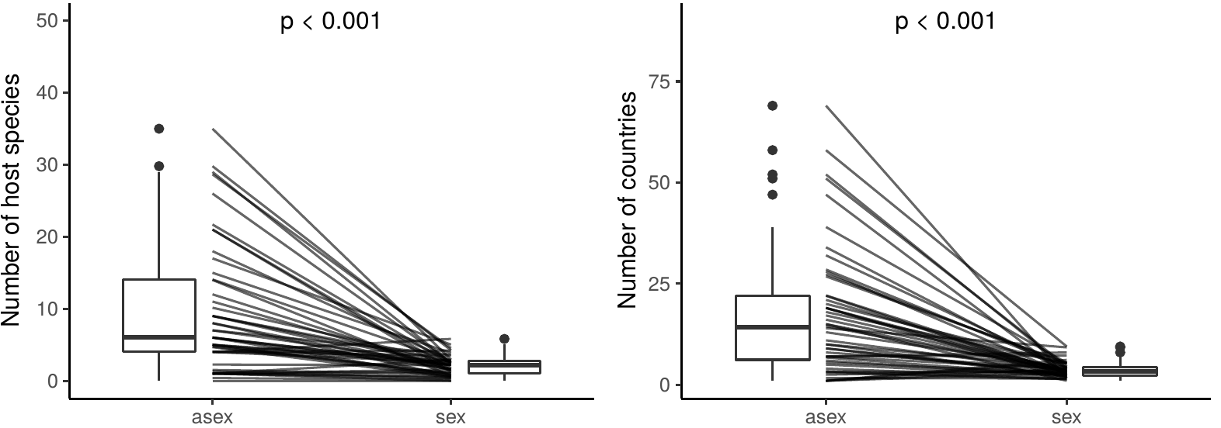
Asexuals have more host species
Manual dataset:
Values per pair
Automated dataset
Values per genus
Generalized linear mixed models:
n.hosts ~ mode + (1| genus / pair)
n.hosts ~ mode + (1| genus)

Slide 7
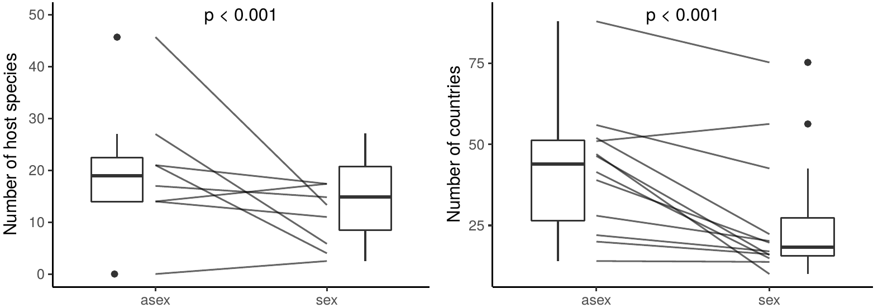
Asexuals have more host species
Manual dataset:
Values per pair
Automated dataset
Values per genus
Generalized linear mixed models:
n.hosts ~ mode + (1| genus / pair)
n.hosts ~ mode + (1| genus)

Slide 8
Asexuals are found in more countries
Manual dataset:
Values per pair
Automated dataset
Values per genus
Generalized linear mixed models:
n.countries ~ mode + (1| genus / pair)
n.countries ~ mode + (1| genus)

Slide 9
Asexuals are found in more countries
Manual dataset:
Values per pair
Automated dataset
Values per genus
Generalized linear mixed models:
n.countries ~ mode + (1| genus / pair)
n.countries ~ mode + (1| genus)

Slide 10
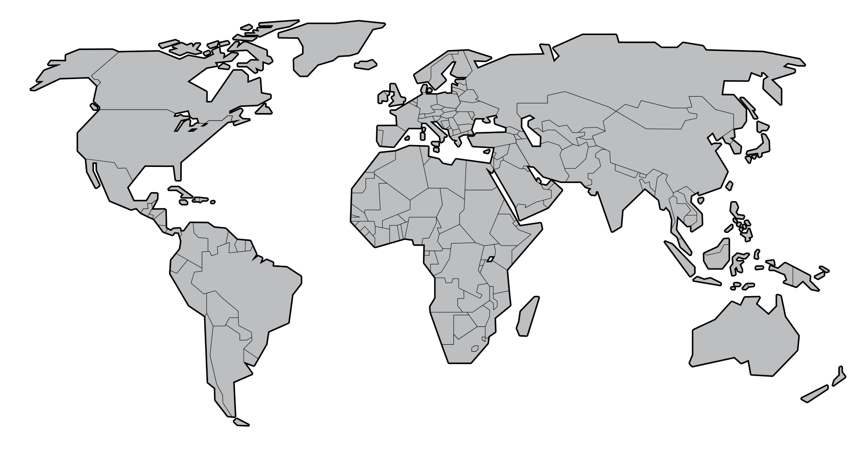
Zooming in on distribution
Geographical distribution in more detail using latitude
Max distance from equator.
Min distance from equator

Slide 11
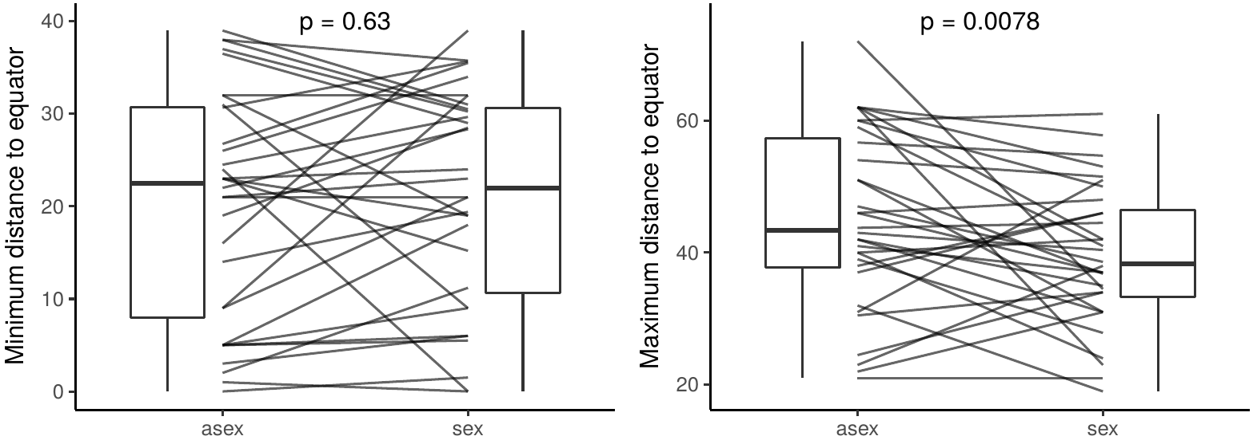
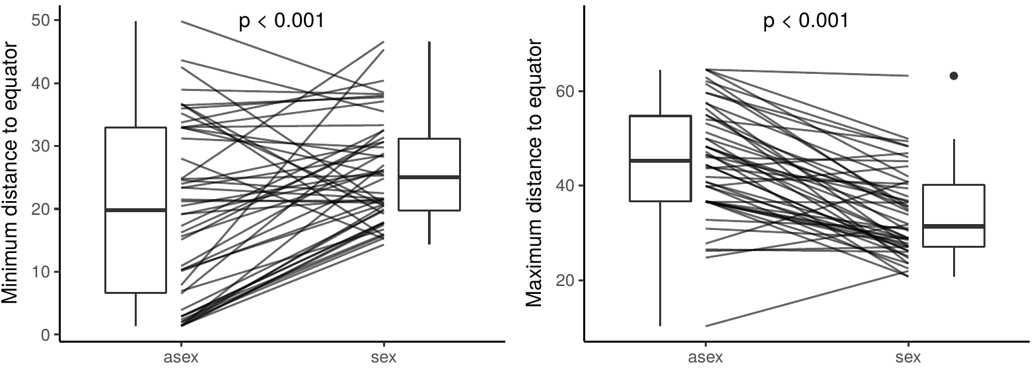
Distribution of asexuals expands towards poles
Manual dataset:
Automated dataset:

Slide 12
Distribution of asexuals expands towards poles
Manual dataset:
Automated dataset:

Slide 13
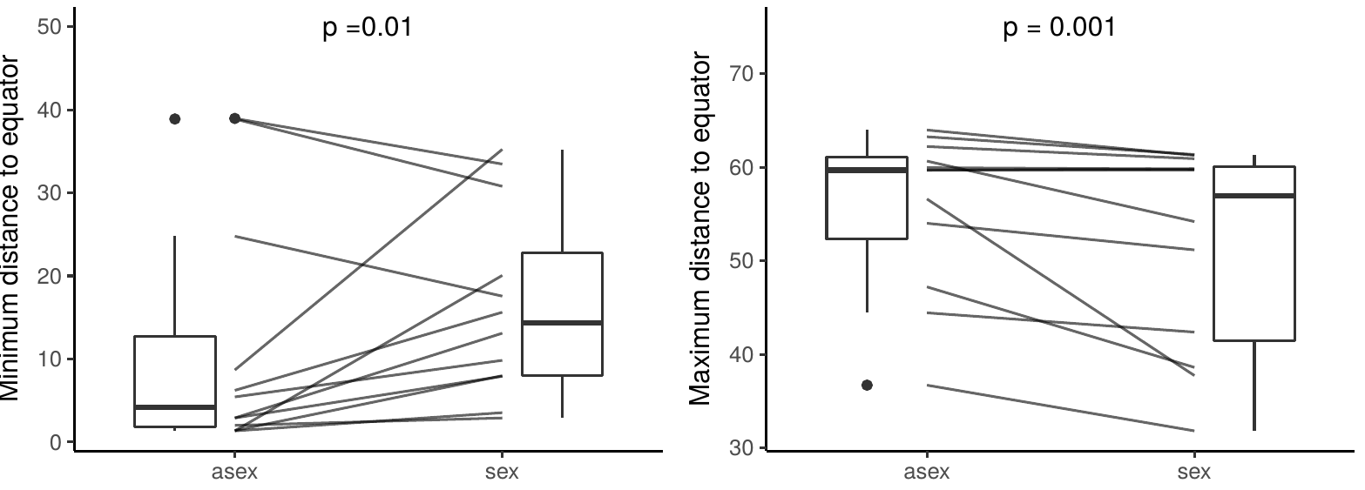
Distribution of asexuals expands towards poles
Manual dataset:
Automated dataset:

Slide 14
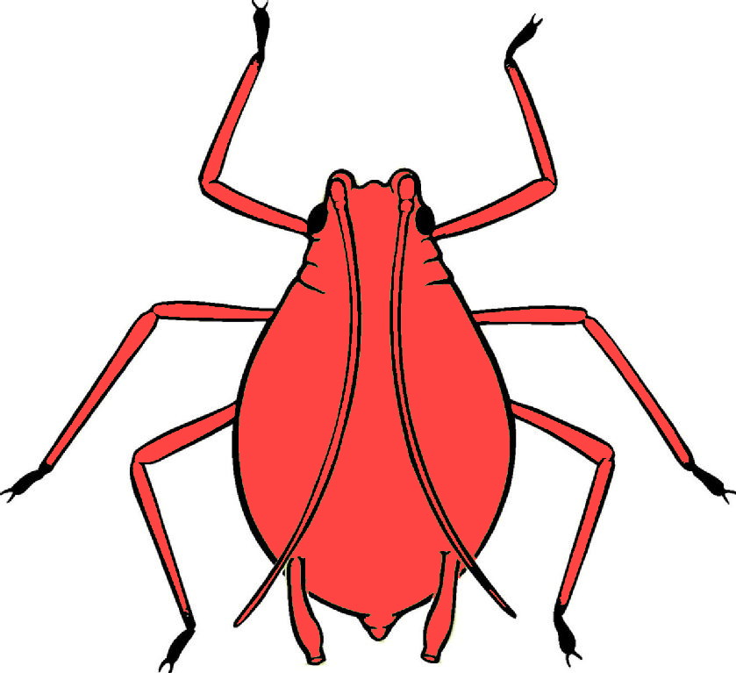
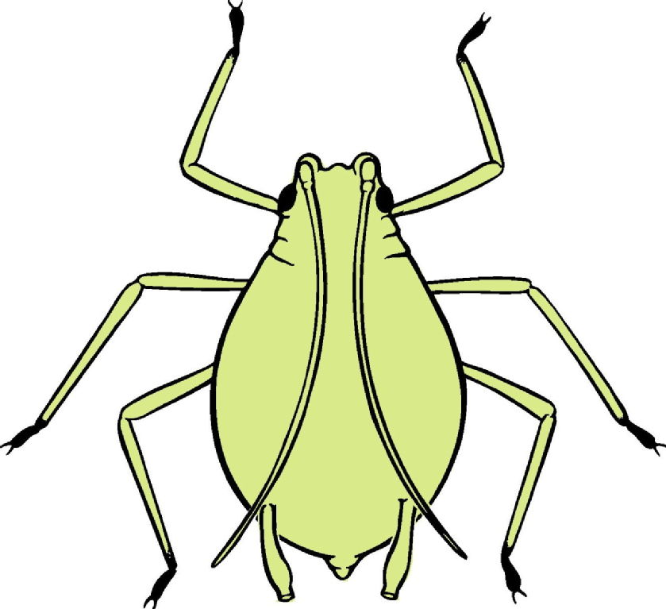
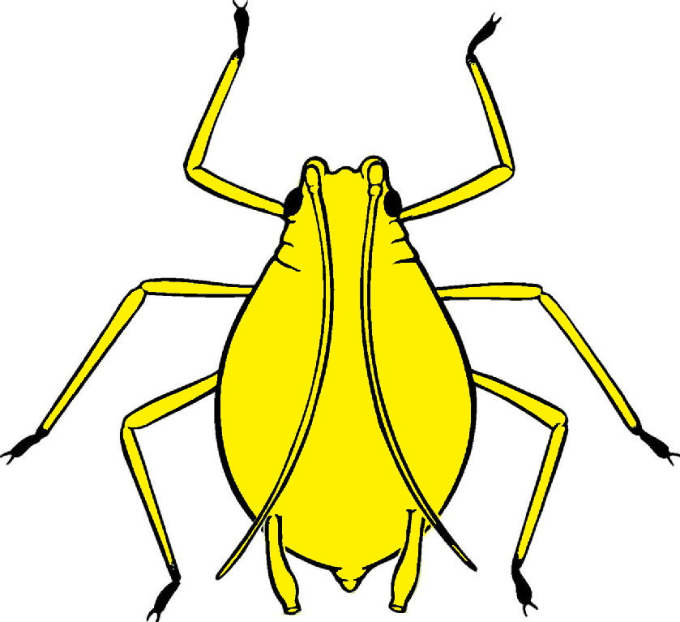
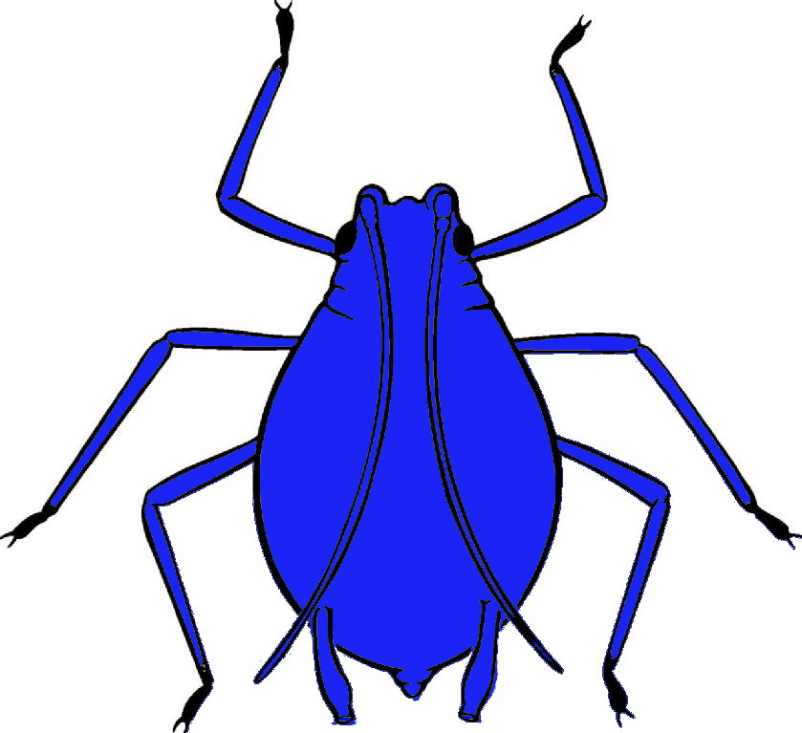
Does asexuality increases niche width ?
Does the broad niche evolve after transition to asexuality?
Or are sexuals with broad niche more likely to give rise to asexuals?
Sex
Asex
Sex
Asex
Sex
Asex

Slide 15
Does asexuality increases niche width ?
Genus X
Sister species
Outgroup
vs
Comparing number of host species and countries between sister species and outgroups in each genera

Slide 16
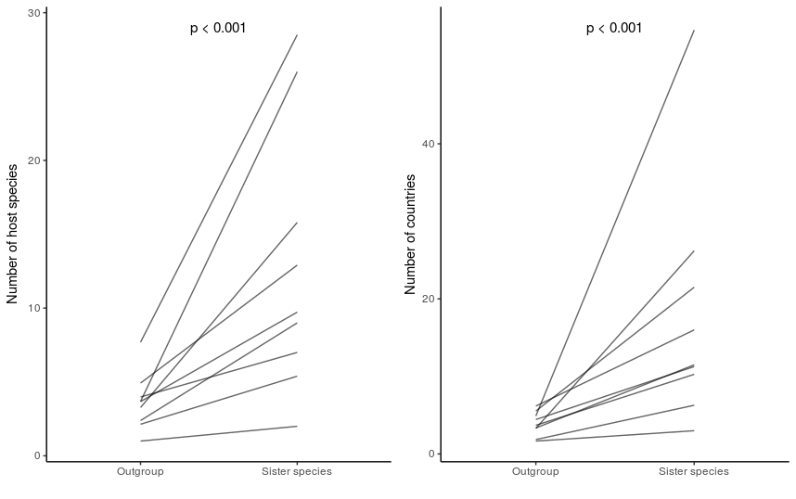
Sexual species from which asexual species diverged already had a large niche
Outgroup
Sister species
Outgroup
Sister species

Slide 17
Conclusions
Asexuals have wider niches:
Found in more countries and hosts than sexuals
Colonization advantage ?
Their geographical distributions expand more towards poles.
Better adaptation to cold climates ?
Ecological attributes favour the transition of asexual lineages.
Asexual
Sexual

Slide 18
Acknowledgements
Casper van der Kooi
Tanja Schwander
Schwander group

Slide 19
Supplementary slides

Slide 20
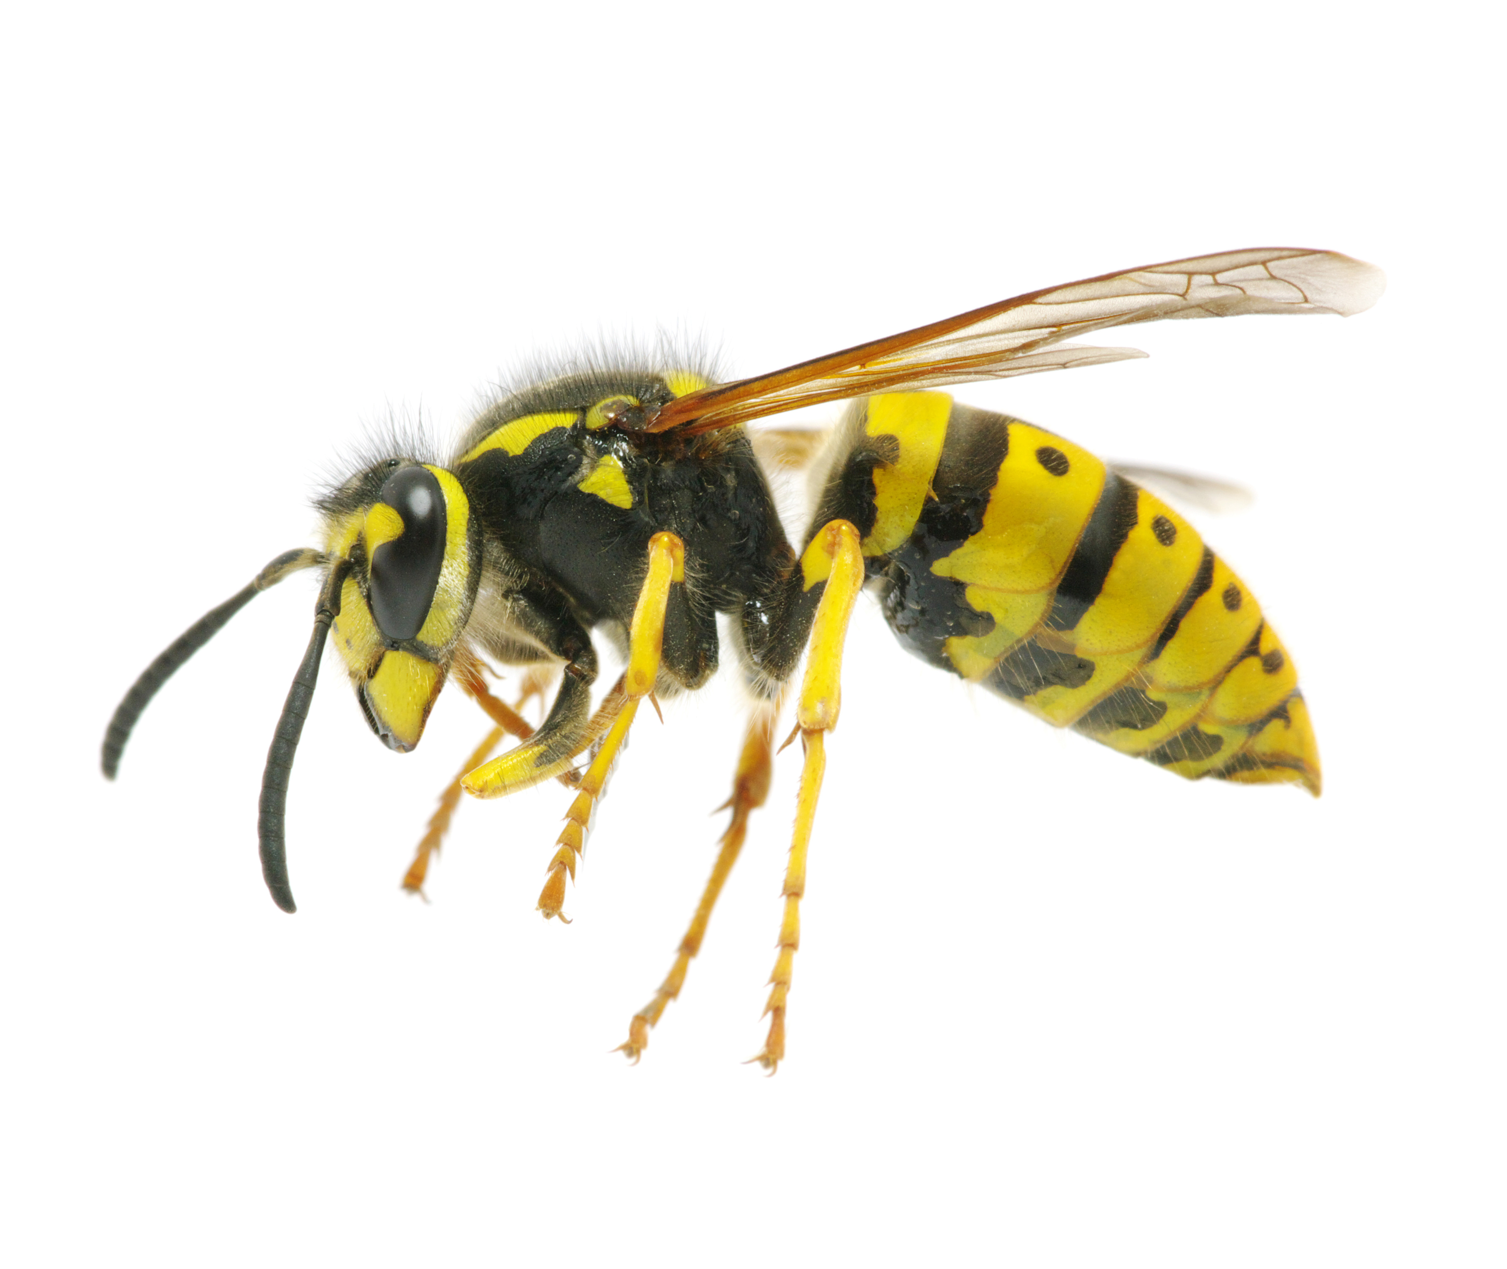
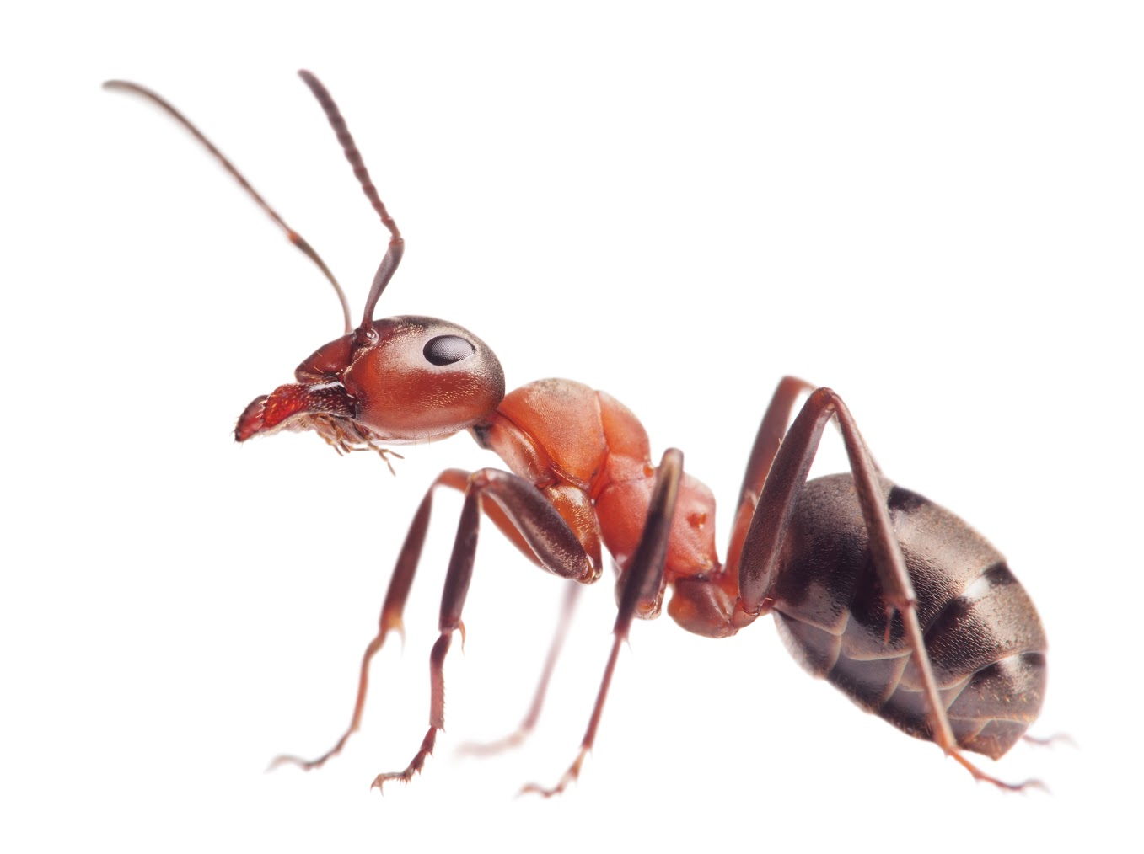

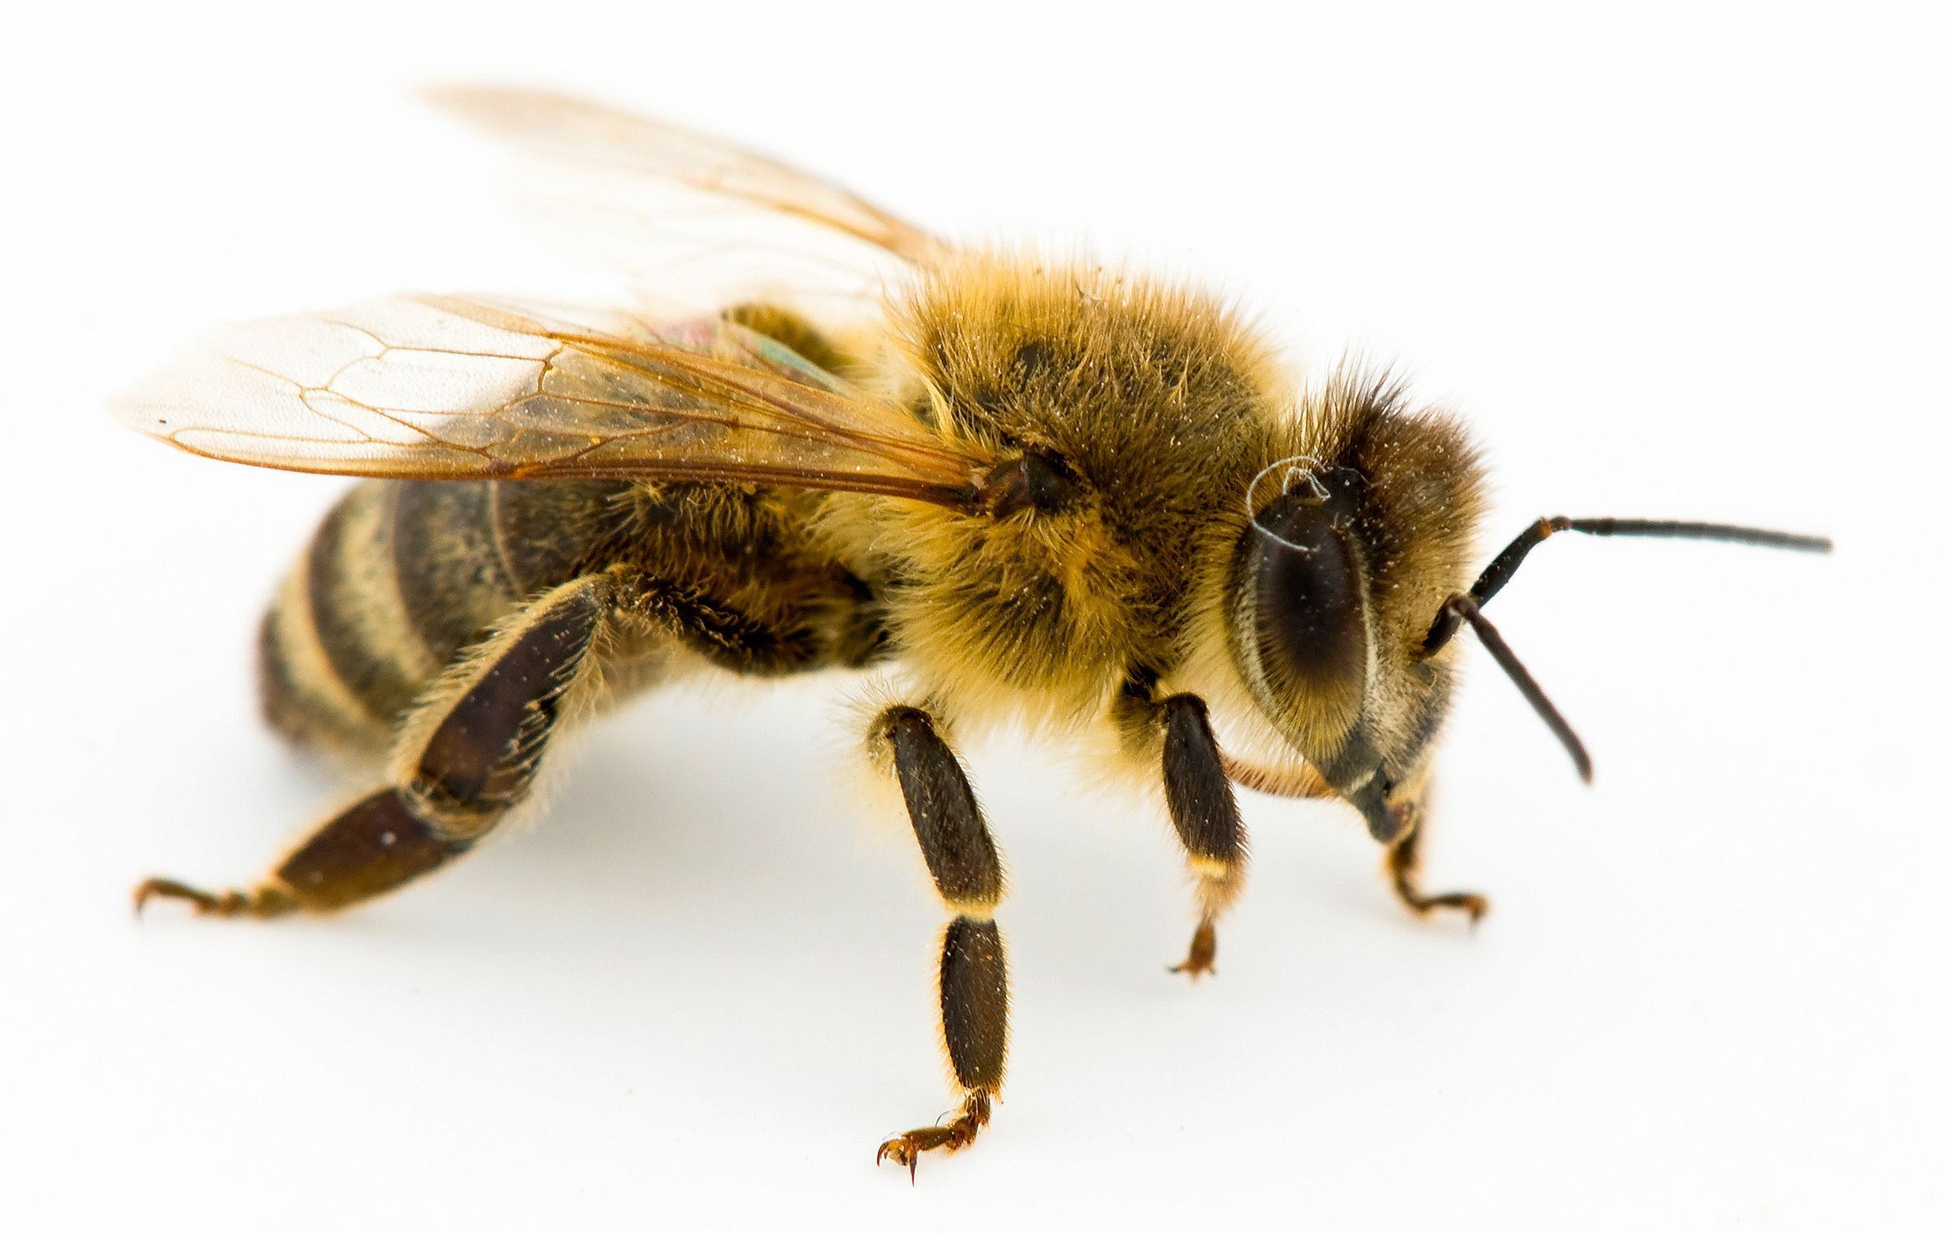
Haplodiploid arthropods
Occurs in many insect species
Offspring can develop without egg fertilization (parthenogenetically)
sexual
asexual
+

Slide 21



Manual dataset: flowchart
Host range
Body length
Pairs
Distribution

Slide 22
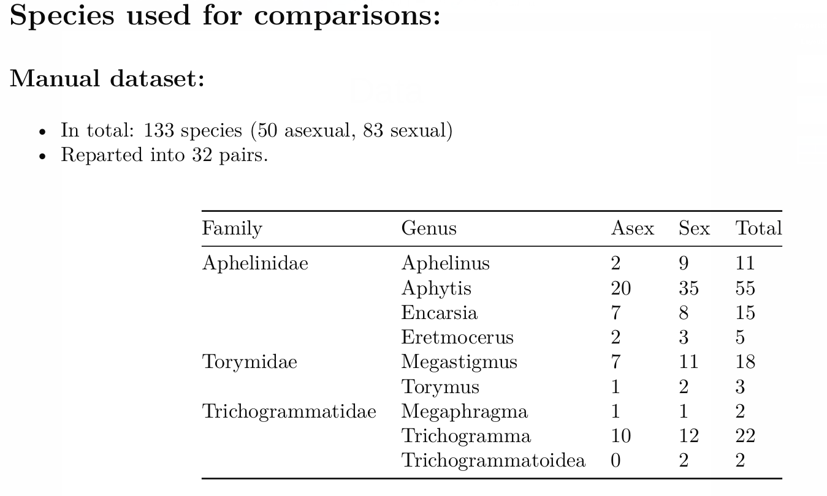
Manual dataset: Data

Slide 23



Automated dataset: flowchart
Only genera with at least one known parthenogen were used.
Nominatim:
Extracting coordinates
Stored for analysis
NHM Database
Host range
Distribution
Distribution
Host range

Slide 24
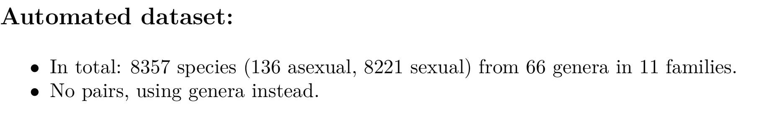
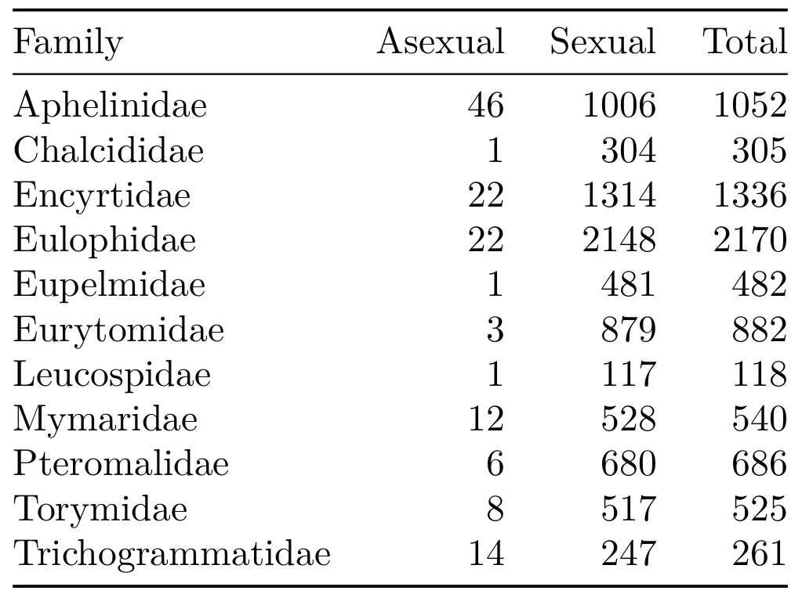
Automated dataset: Data

Slide 25
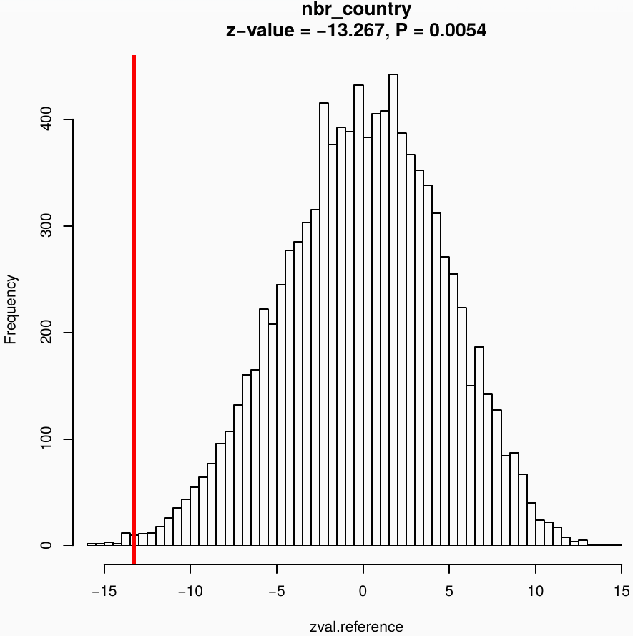
GLMM with permutation approach
asex
sex
model
Observed
statistic
observed
Genus
Random permutations
[...]
10,000 simulations
Reference
distribution

Slide 26
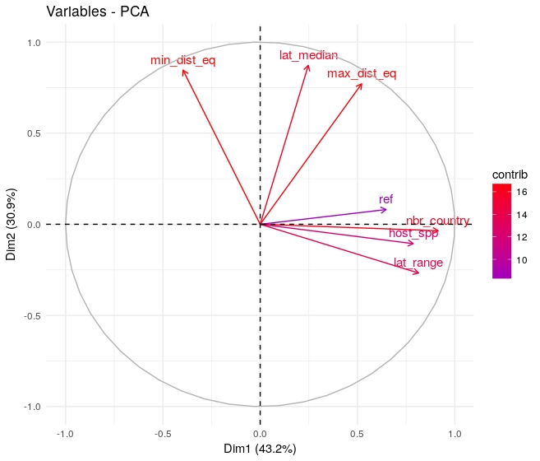
Automated dataset: Publication bias
Species with unknown reproductive mode considered sexual
Some variables strongly correlate with number of publications (ref)

Slide 27
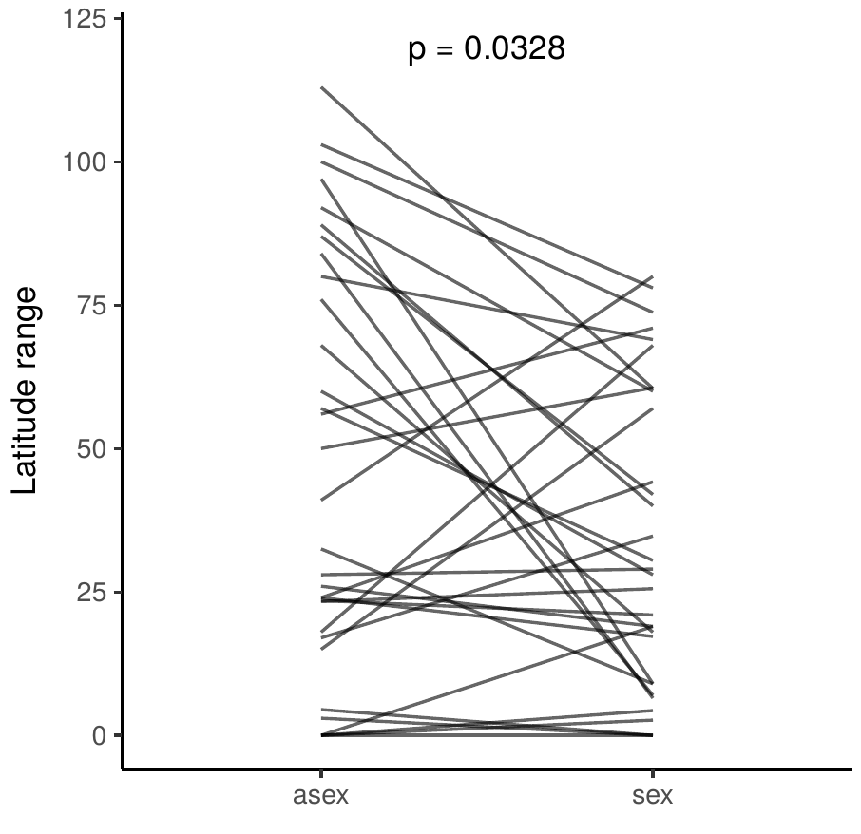
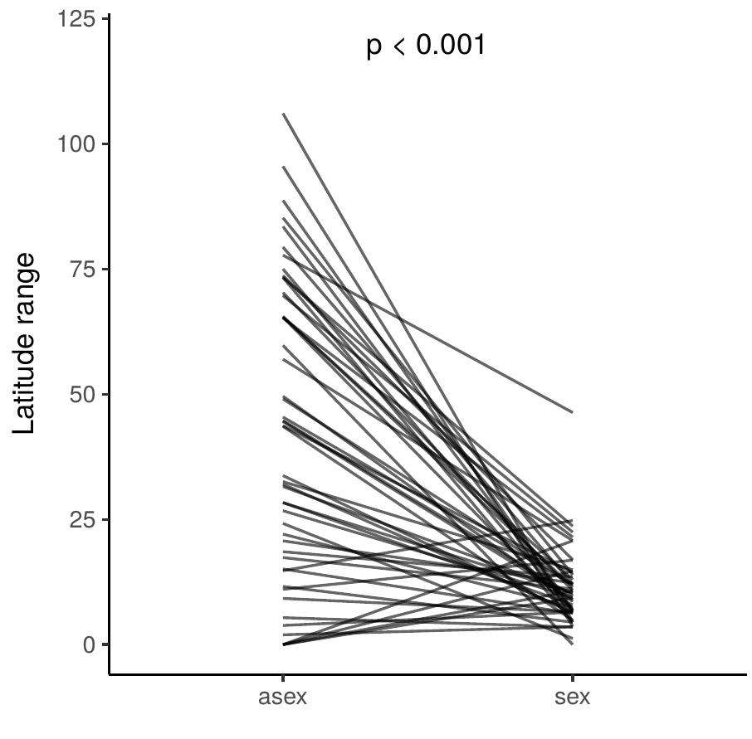
Results: Latitude range
Manual dataset:
Values per pair
Automated dataset
Values per genus

Slide 28
Automated dataset: Publication bias
Removing species with low number of publications
Trade off: bias vs power
Reference Cutoff | species | N.countries | N.hosts | Min.dist.eq | Max.dist.eq
0 | 8328 | 0 | 0 | 0 | 0
5 | 1089 | 0 | 0 | 0.0005 | 0
10 | 379 | 0.0004 | 0 | 0.01 | 0.0012
15 | 202 | 0.035 | 0.0082 | 0.114 | 0.074
20 | 113 | 0.0234 | 0.0244 | 0.2006 | 0.1452

Slide 29
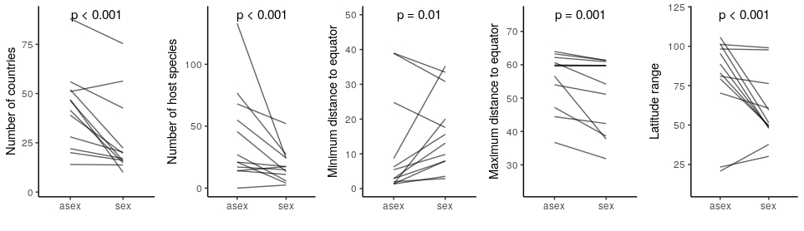
Automated dataset: Publication bias
Poorly studied species: unknown reproductive mode
considered sexual
Sexual species will have fewer known hosts and countries
Results are consistent when including only well studied species (>10 publications)
asex
sex
asex
sex
asex
sex
asex
sex
asex
sex

